Slide 1




Graduate Programs in Genetic Counseling
United States: Current Environment and Challenges
Cathy Wicklund, MS, CGC
Director, Graduate Program in Genetic Counseling
Northwestern University, Chicago Illinois

Slide 2
Current status of programs in the
United States
33 Programs
  2 new programs under review
  2 programs known to be working on application
  Others?
  Number of graduates per year
  Number of students matriculating in 2016 (including Canadian schools): 317
What do students do after completion of their degree
  No additional clinical training, residency etc. is required after completion
  Go directly into the job market
2010 | 2011 | 2012 | 2013 | 2014 | 2015
212 | 232 | 223 | 214 | 247 | 276

Slide 3
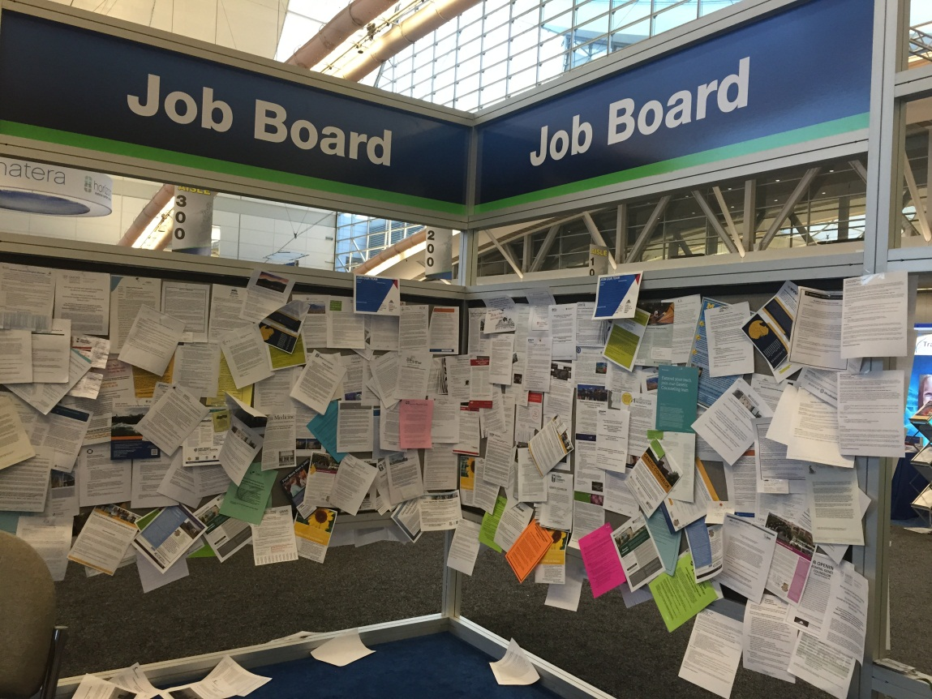
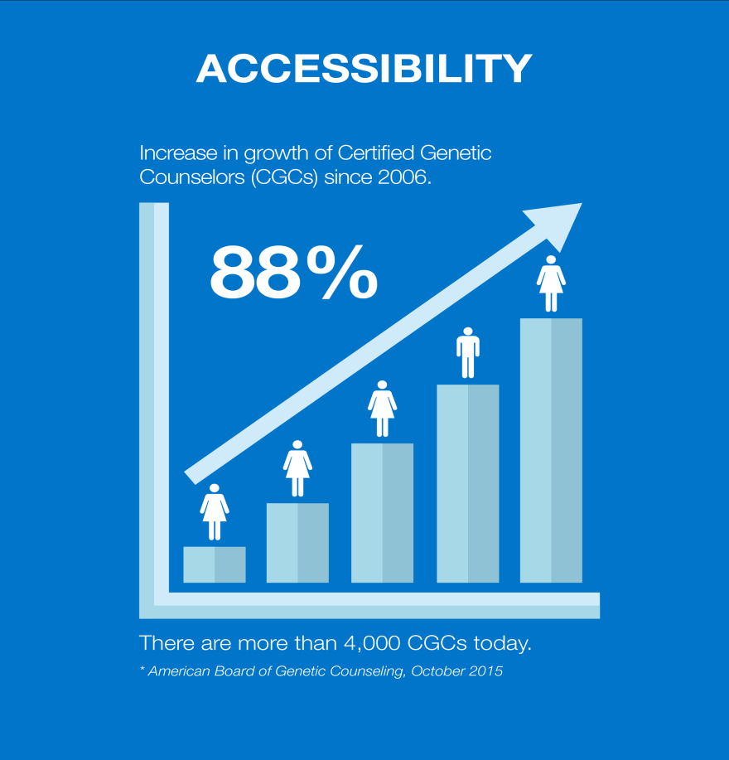
Genetic Counselor Workforce
Is there a shortage?
Notes:
Genetic counselor workforce shortage. By a show of hands how many in the room would say we are there? Historically there has been an assumption of a genetic counselor shortage. However, those conclusions came from research focused on genetic specialists and geneticists, not genetic counselors specifically. If there was a shortage one might assume wait times for genetic counselors would be significant and that job openings would go unfilled. The NSGC Professional Status Survey in the past demonstrated that wait times were in fact very reasonable. And with telegenetics geography was in large part taken off the table too.
However the PSS is 2 yrs old. In meetings with other provider groups it is common to hear they don’t utilize genetic counselors due to the percieved shortages. While thier perception may be inconsistent with the past PSS data, what if these providers where all utilizing genetic counselors today? Many of their patients would certainly benefit from genetic counselor services but if they were referring more what would wait times look like? On the job front, openings are also going unfilled for longer periods of time compared to the past.

Slide 4
Workforce Working Group
Established in 2013 as a group of GCs from the four genetic counseling organizations interested in these issues
Working group tracking action on workforce initiatives within ABGC, ACGC, AGCPD, NSGC
  Ensuring collaboration and avoiding duplication of effort
Focused on collaborative efforts to grow and maximize the capacity of the genetic counselor workforce:
  Growth
  Efficient, effective service delivery
  Diversity

Slide 5
Workforce Working Group
Identified need for workforce analysis to assess demand for GC services into the future
  Clinical – What is patient demand, now and in the future?
  Industry – How is science and technology evolving + patient demand?
  How do we train enough GCs to meet the demand?
  What else can we do to meet the demand?
Notes:
We need to figure out the potential demand – how many patients would benefit from your services. Workforce is a complex issue with many factors to consider.
Profession must meet the demand for services or the healthcare delivery system will find a way to meet it – i.e. utilizing other practitioners or technology whether it is in the interest of patients or not. This may be happening now.
At the same time, we don’t want to overshoot the demand and expand the workforce beyond what is sustainable over the long-term.
Today there isn’t a landmark study that provides a reasonable estimate of demand over the next 10 years (or for any time period).

Slide 6

Workforce Analysis
Working with external research firm
  They guide the process
  We provide context, data, direction, expertise
  Short, efficient timeline to generate results
Workforce analysis an exciting collaboration between genetic counseling organizations:
  In-kind support from ACGC and AGCPD
  Funding from ABGC, NSGC, ASHG
Report expected in June 2016
  Will drive strategies within GC organizations
  Data to support “asks” of other stakeholders

Slide 7
ACGPD Retreat: Summer 2014
Focused on workforce issues
  Reviewed existing data on barriers to expansion (Pan et. al. 2015)
  Strategic planning to validate data previous collected
    Determined barriers that are under control of AGCPD
    Prioritized barriers
    Work Groups formed around barriers with goal to develop solutions

Slide 8
Supporting Program Development
Explore how AGCPD can be a catalyst for the development and support of new programs
Consider data needed such as:
  How are programs funded and how is funding utilized?
Explore new sources of program funding
Consider policy that could affect funding
Consider potential collaborations (federal, industry, private etc.)

Slide 9
Recruitment Work Group
Investigate applicant pool, develop pipeline, address diversity issues
  What are the problems we face with recruitment?
  What additional data do we need?
    Describe the current applicant pool
  What about the issue of diversity in the profession?

Slide 10
Program Director Pipelines
Explore existing pipelines for program directors
  No formal pipelines to positions of program director
  Informal pipelines include:
    Rising internally within programs
    Associate and Assistant directors may aim to become PDs
    Word of mouth within AGCPDs
Identify novel opportunities for enhancing pipelines

Slide 11
Genetic Counseling Training
Consider ways to improve efficiency in clinical training with the goal of clinics increasing the number of students trained at each site.
  Different models of supervision
  Culture of training including self imposed restrictions
  Ways to incentivize supervisors
  Collaborate with ACGC to reexamine case requirements
Consider other models of training to allow for expansion

Slide 12
ACGC: Key Question
Are accreditation practices hindering or enhancing the growth of the genetic counseling profession?
  Educational models
  Fiscal limitations
  Size of programs
  Establishment of new programs
  Continuation of existing programs
  Resources

Slide 13
ACGC: Strategic Initiatives
Build ACGC policies, procedures, documents and training that are efficient, effective and strategic.
Develop and implement a systematic process for periodically evaluating accreditation standards, policies and procedures.
Develop, implement, and evaluate an engagement strategy for ACGC’s key internal and external stakeholders.
Notes:
Future, looking at education delivery modes, focus on outcomes to allowing programs greater flexibility as long as educational outcomes are achieved.
Data at FTE ratios, quality metrics for entry level genetic counseling, educational activities for Board, role of mentorship

Slide 14
ABGC: Certification Eligibility Taskforce
Charge:
  Propose a set of robust eligibility criteria to evaluate the process of accreditation or an accreditation body
Rationale: Recommendation of the Institute for Credentialing Excellence (ICE)
  ABGC must document the process and rationale used in setting or reviewing eligibility criteria for certification to ensure an appropriate level of rigor/quality is employed in the accreditation of genetic counseling training programs
Notes:
NCCA is the accrediting body of the Institute for Credentialing Excellence and ICE is their oversight body.
When ABGC became certified by NCCA, they agreed to put some recommendations from ICE into practice, one being establishing standards for an accreditation organization. It is possible that at some point in the future, another organization could try to form to accredit genetic counseling training programs. ABGC wants to be proactive in having standards for accreditation programs, including ACGC, so they can evaluate any future request, should one come along. This would mean that any new accreditation body would have to meet the same set of standards that ACGC meets to ensure that any training programs certified by any new accrediting body would be graduating students eligible to sit for the certification exam.
This protects the accreditation status of current programs, ensuring no programs could be established that aren’t on par with existing programs.
This protects the value of your certification by ensuring that all certified GCs have completed a training program meeting an established standard.

Slide 15
ABGC: Practice Analysis
Practice Analysis used to define:
  Performance domains and tasks performed by a profession
  Necessary knowledge and skills associated with these tasks
This information can be used to develop a relevant and valid certification exam supported by evidence-based data.
Each CGC will be asked to judge the importance of job-related tasks describing what practicing genetic counselors do.
Rate these tasks based on expectations in your current position.
Notes:
Practice analysis informs the certification exam and helps drive change in training programs by helping to inform what should be covered in GC training.
Also looked to by policymakers and others to help outline what genetic counselors do – e.g. US DOL job classifications.

Slide 16
Questions?

